Slide 1
Predicate Logic
CSE 2213 – Discrete Mathematics

Slide 2
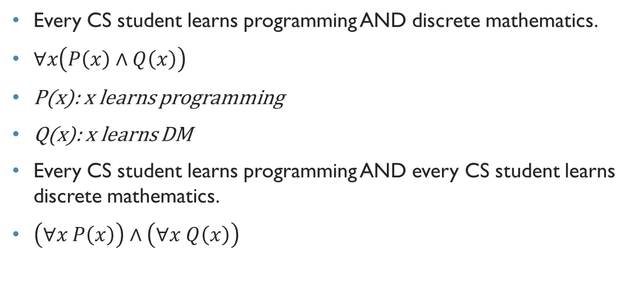
Logical equivalences involving quantifiers
Every CS student learns programming AND discrete mathematics.
$∀x\left(P\left(x\right)∧Q\left(x\right)\right)$
P(x): x learns programming
Q(x): x learns DM
Every CS student learns programming AND every CS student learns discrete mathematics.
$\left(∀x P\left(x\right)\right)∧\left(∀x Q\left(x\right)\right)$

Slide 3
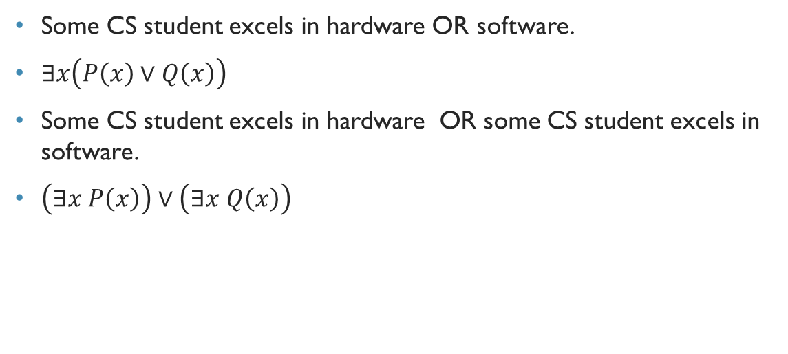
Logical equivalences involving quantifiers
Some CS student excels in hardware OR software.
$∃x\left(P\left(x\right)∨Q\left(x\right)\right)$
Some CS student excels in hardware OR some CS student excels in software.
$\left(∃x P\left(x\right)\right)∨\left(∃x Q\left(x\right)\right)$

Slide 4

Negating quantified expressions
De Morgan’s Laws for Quantifiers
$¬\left(∀x P\left(x\right)\right)≡∃x ¬P\left(x\right)$
$¬\left(∃x P\left(x\right)\right)≡∀x ¬P\left(x\right)$

Slide 5

It’s NOT that every CS student has taken calculus.
$≡$ Some CS student has not taken calculus.

Slide 6

It’s NOT that some CS student has taken calculus.
$≡$ Every CS student has not taken calculus.

Slide 7

Rosen, page 41, example 21
What are the negations of these statements?
$∀x\left(x^{2}>x\right)$
$∃x(x^{2}=2)$
Domain: All positive integers

Slide 8
Rosen, page 41, example 20
What are the negations of the statements "There is an honest politician" and "All Americans eat cheeseburgers"?

Slide 9
Translating from English to Logical Expressions

Slide 10
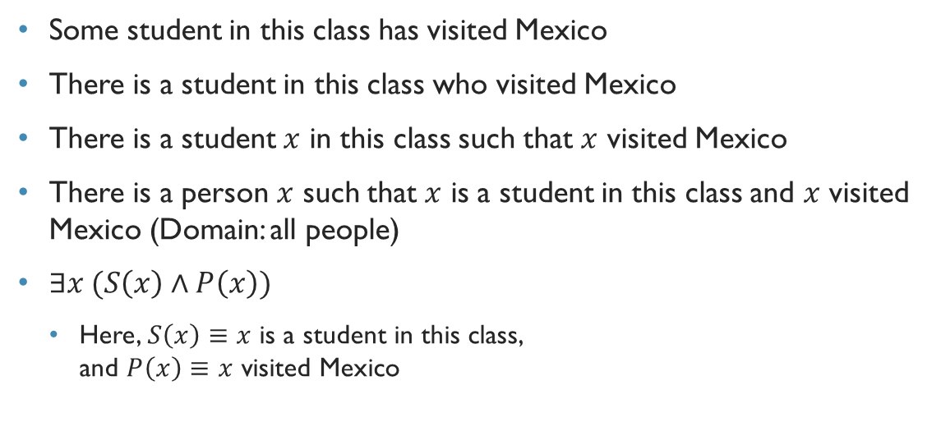
Rosen, page 42, example 24, part 1
Some student in this class has visited Mexico
There is a student in this class who visited Mexico
There is a student $x$ in this class such that $x$ visited Mexico
There is a person $x$ such that $x$ is a student in this class and $x$ visited Mexico (Domain: all people)
$∃x (S\left(x\right)∧P\left(x\right))$
Here, $S\left(x\right)≡x$ is a student in this class, and $P\left(x\right)≡x$ visited Mexico

Slide 11
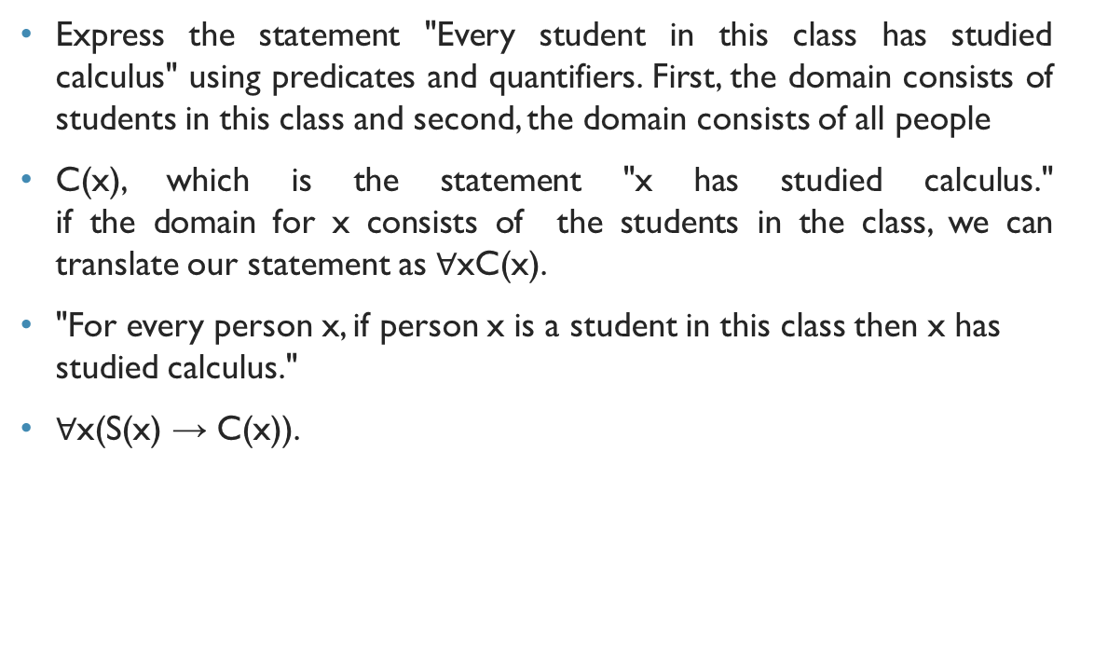
Rosen, page 42, example 24, part 1
Express the statement "Every student in this class has studied calculus" using predicates and quantifiers. First, the domain consists of students in this class and second, the domain consists of all people
C(x), which is the statement "x has studied calculus." if the domain for x consists of the students in the class, we can translate our statement as $∀$xC(x).
"For every person x, if person x is a student in this class then x has studied calculus."
$∀$x(S(x) → C(x)).

Slide 12
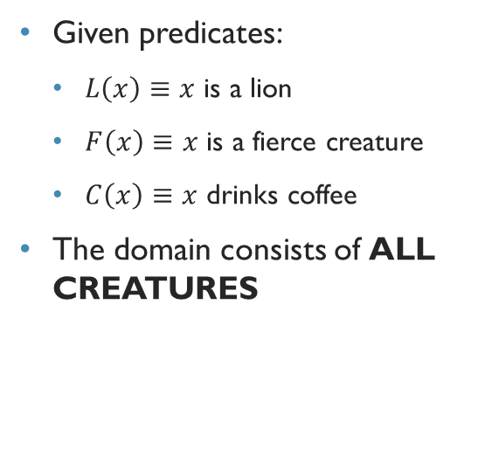
Example Rosen, page 44, example 26
Express the following statements using the given predicates and quantifiers:
All lions are fierce.
Some lions do not drink coffee.
Some fierce creatures do not drink coffee.
Given predicates:
$L\left(x\right)≡x$ is a lion
$F\left(x\right)≡x$ is a fierce creature
$C\left(x\right)≡x$ drinks coffee
The domain consists of ALL CREATURES

Slide 13
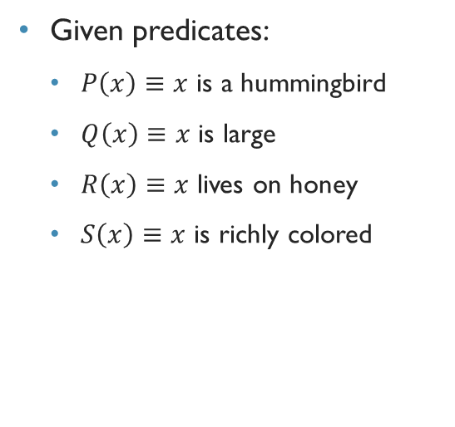
Example Rosen, page 45, example 27
Express the following statements using the given predicates and quantifiers:
All hummingbirds are richly colored.
No large birds live on honey.
Birds that do not live on honey are dull in color.
Hummingbirds are small.
Given predicates:
$P\left(x\right)≡x$ is a hummingbird
$Q\left(x\right)≡x$ is large
$R\left(x\right)≡x$ lives on honey
$S\left(x\right)≡x$ is richly colored
Notes:
No large birds live on honey = For all birds x, if x is large then it does not live on honey

Slide 14

Nested quantifier
For all values of $x$ and $y$, $x+y=y+x$
How to represent this using quantifiers?

Slide 15
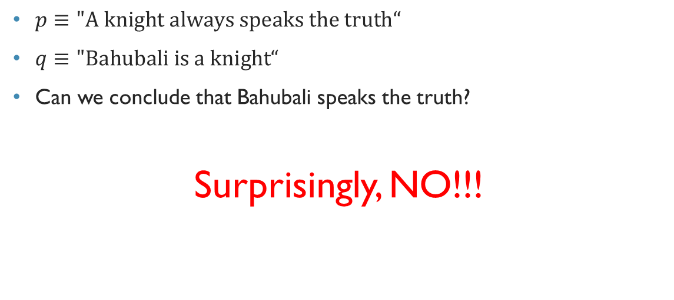
Nested quantifiers
Quantifier used within the scope of another quantifier
The example from previous slide: $∀x∀y(x+y=y+x)$
We can put any quantifier within the scope of any quantifier
Quantifiers are read left-to-right

Slide 16
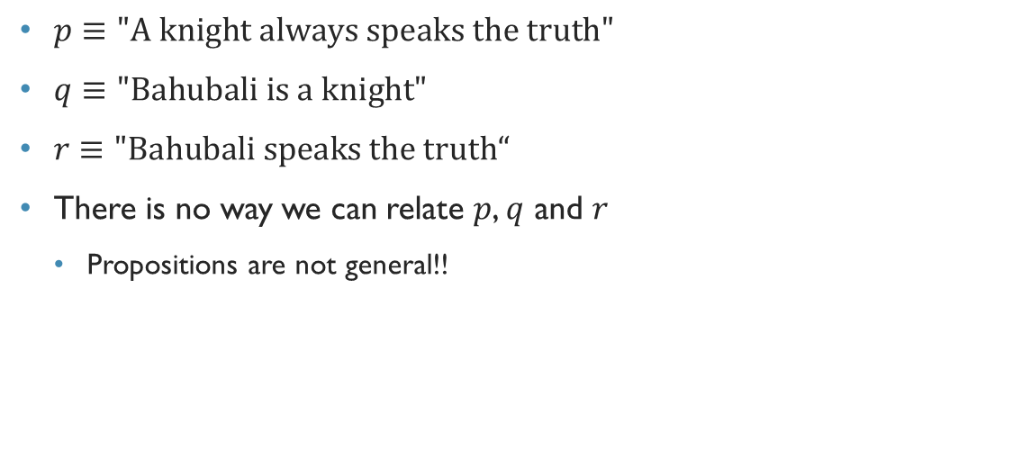
Another example:
For every real number $x$, there is a corresponding real number $y$ such that $x+y=0$.
How do we represent it using quantifiers?
$∀x∃y(x+y=0)$

Slide 17
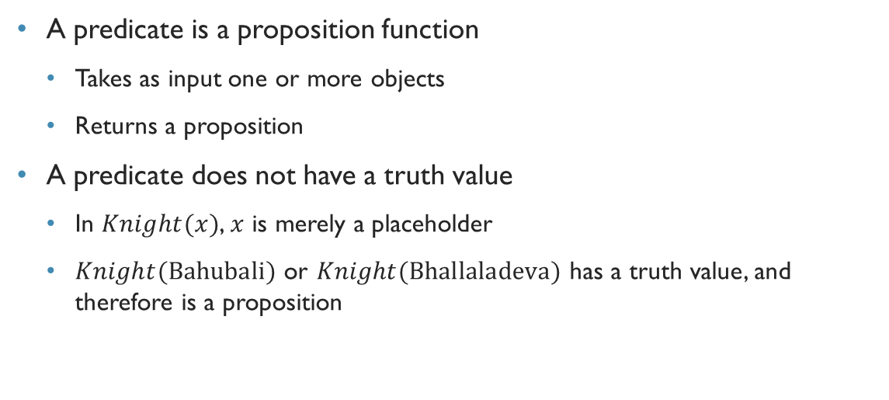
Order of quantifiers
Commutative law: $∀x∀y(x+y=y+x)$
Can we rewrite this as $∀y∀x(x+y=y+x)$??
What does it mean?
Is the original meaning changed?

Slide 18
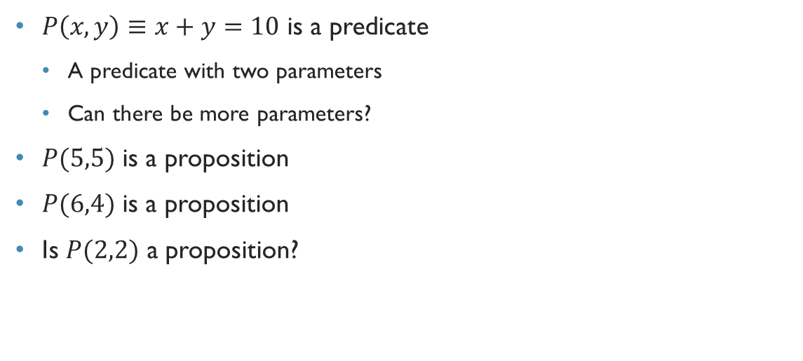
Order of quantifiers
Some random observation: $∃x∃y(xy=6)$
Can we rewrite this as $∃y∃x(xy=6)$??
What does it mean?
Is the original meaning changed?

Slide 19

Order of quantifiers
$∀x∃y(x+y=0)$
Can we write it as $∃y∀x(x+y=0)$??
What does it mean?
Is the original meaning changed?

Slide 20
Order of quantifiers
If only universal or only existential quantifiers are nested, their order can be changed
If both quantifiers are nested, their order cannot be changed, otherwise the meaning will be changed

Slide 21

Quick exercise
Find out the truth values of the following:
$∀x∃y(x+y=0)$
$∃y∀x(x+y=0)$

